Slide 1


Sripathi M
18-Jan-2026

Slide 2

Outline
Executive Summary
Introduction
Methodology
Results
Conclusion
Appendix

Slide 3
Executive Summary
Summary of methodologies – Comprehensive data science tools to predict success of first-stage rocket landings
Working with data – data collection, data wrangling, exploratory data analysis (EDA)
Visualization of data – interactive visual analytics and dashboard
Predictive modeling – develop and fine tune classification models
Key Python libraries – Numpy, Pandas, Matplotlib, Seaborn, Plotly, Folium, Scikit-learn
Summary of all results
Safety: Geographic analysis confirmed that most launch sites are strategically located near coastlines and away from major population areas
Launch Success Trends: Landing success rates have shown a significant upward trend over time
Site Performance: KSC LC-39A was identified as the launch site with the highest success rate
Orbit & Payload Impact: Specific orbits like ES-L1, GEO, HEO, and SSO achieved a 100% success rate

Slide 4
Introduction
Project background and context
To predict if the Falcon 9 first stage will land successfully
Falcon 9 rocket launches cost $62 million, much of the savings is because the first stage ca be reused
Therefore determining the first stage landing, we can determine the cost of a launch
Problems you want to find answers
What variables (e.g., payload mass, launch site, orbit type, flight number) most influence the success rate of a landing?
Does the success rate of landings improve over the years with experience?
Which machine learning algorithm provides the best prediction accuracy for landing outcomes?

Slide 5

Section 1

Slide 6
Methodology
Executive Summary
Data collection methodology:
Data sourced from both primary (SpaceX REST API) and secondary (Wikipedia's list of Falcon 9 launches) sources, ensuring a comprehensive dataset
Perform data wrangling
Handling of missing values, standardization, statistical analysis, data visualization, feature engineering
Perform exploratory data analysis (EDA) using visualization and SQL
Perform interactive visual analytics using Folium and Plotly Dash
Perform predictive analysis using classification models
Comparison and evaluating accuracy and score among 4 models including tuning using GridSearchCV and visualizing with confusion matrices

Slide 7
Data Collection
Source of data collection to ensure a comprehensive dataset
Data sourced from primary (original) sources SpaceX REST API using HTTP requests, from which launch data was programmatically extracted
A secondary source, Wikipedia's list of Falcon 9 launches, was web scraped using Python libraries to gather supplementary details not available via the API
Merged both datasets into one single data frame and filtered for Falcon9 launches

Slide 8
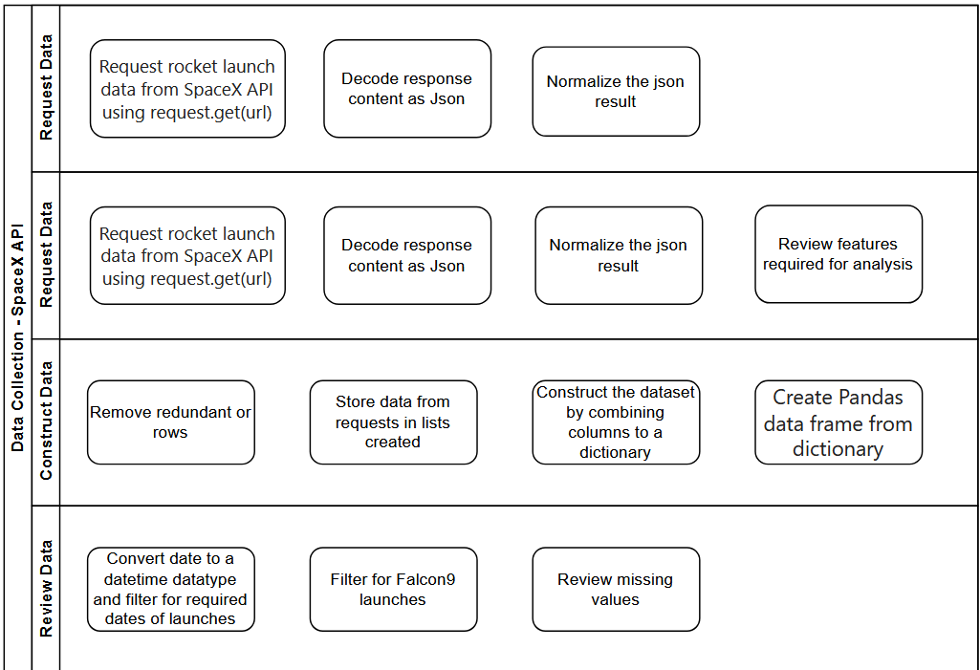
Data Collection – SpaceX API
GitHub URL of SpaceX API calls → https://github.com/sripathi747/Capstone-Project/tree/main/Data%20Collection_Web%20Scraping_Wrangling

Slide 9
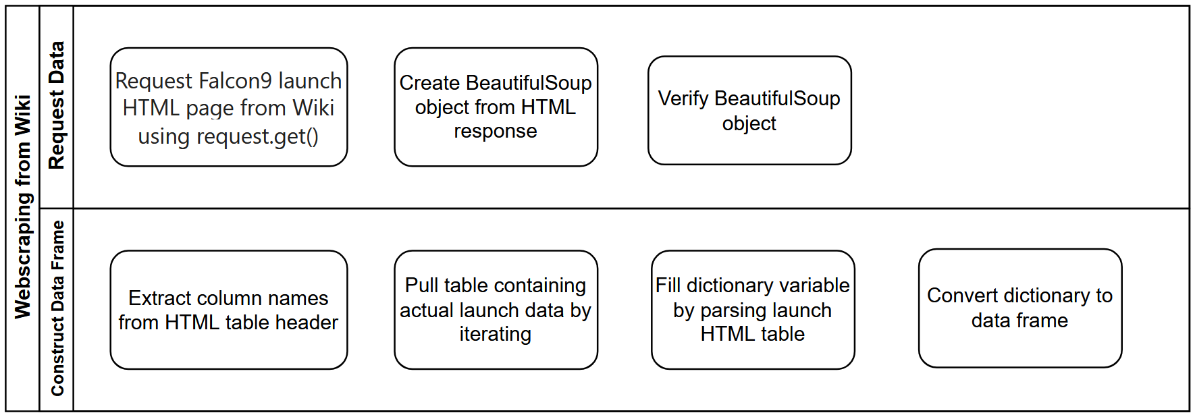
Data Collection - Scraping
GitHub URL of Webscraping → https://github.com/sripathi747/Capstone-Project/tree/main/Data%20Collection_Web%20Scraping_Wrangling

Slide 10
Data Wrangling
Identified numerical and categorical variables
Missing values reviewed for each column
Defined predicting variable called landing class variable consisting of 0 (failure) or 1 (otherwise)
Site launches data
Reviewed counts of launches from each launch site that is not a geostationary
Outcome of launches from each site
Success rate based on successful launches
GitHub URL of data wrangling → https://github.com/sripathi747/Capstone-Project/tree/main/Data%20Collection_Web%20Scraping_Wrangling

Slide 11
EDA with Data Visualization
Flight Number vs Payload Mass plot revealed that even with higher payload, the first stage returns successfully
Scatter plot of Flight Number vs Launch Site and Payload Mass vs Launch Site grouped by success or failure class shows that CCAFS SLC 40 site has maximum launches with high success rate, for both high and low payload
Bar chart of Success rate vs Orbit shows that ES-L1, GEO, HEO and SSO orbits have high average success rates
Scatterplot of Flight Number vs Orbit reveals that in the LEO orbit, success seems to be related to the number of flights. Conversely, in the GTO orbit, there appears to be no relationship between flight number and success.
Scatterplot of Year vs Success Rate shows that success rate has an increasing trend, reflecting learnings from past launches
GitHub URL of EDA with data visualization → https://github.com/sripathi747/Capstone-Project/tree/main/Exploratory%20Data%20Analysis

Slide 12
EDA with SQL
Extracting of data using DISTINCT and 5 records from the SPACEXTBL
Querying for total and average payload mass for a customer and booster version
Identifying first successful landing outcome in ground pad
Extracting data of successful and failed mission outcomes
Identifying boosters with success in drone ship and payload mass between 4000 and 6000
Querying for booster version with maximum payload mass
Extracting data for year 2015 that had failed landing outcomes in drone ship
GitHub URL of EDA with SQL → https://github.com/sripathi747/Capstone-Project/tree/main/Exploratory%20Data%20Analysis

Slide 13
Build an Interactive Map with Folium
Folium Circles have been added as a circle area with text label to highlight launch site with specific coordinates
Folium Markers are added as tear drop to identify exactly the launch sites coordinates
Circles and markers are used to mark the launch outcomes for each site
To identify each site with outcomes, marker_cluster() is utilized for marking
Summarize what map objects such as markers, circles, lines, etc. you created and added to a folium map
Using calculate_distance() between launch site coordinates and coordinates of areas of interest such as coasts, railways, etc to find the distance
GitHub URL of interactive map with Folium map → https://github.com/sripathi747/Capstone-Project/tree/main/Interactive%20Visual%20Analytics_Dashboard_Prediction

Slide 14
Build a Dashboard with Plotly Dash
Interactive dashboard built – pie chart for success/failure rate and scatter plot for payload vs success
Pie chart enables to view success vs failure rate of each site or all sites together through the drop-down feature developed
Scatter plot helps to see how payload mass effect outcome of success that is grouped by the booster version
Slider is added in the interactive plot to select the payload range
Scatter plot can be viewed for all sites together or each site separately
GitHub URL of Plotly Dash → https://github.com/sripathi747/Capstone-Project/tree/main/Interactive%20Visual%20Analytics_Dashboard_Prediction

Slide 15
Predictive Analysis (Classification) – 1
Feature Engineering
Based on the data visualization in EDA, features that will be used for predicting outcome are identified
Using get_dummies(), OneHotEncoder is applied to categorical variables (columns)
Data Preparation
Loaded data is segregated into data X for features that are independent variables (features) and data Y for dependent variable (class)
Standardize data in X using fit_transform()
Split training and test data in the ratio 80:20
GitHub URL of predictive analysis → https://github.com/sripathi747/Capstone-Project/tree/main/Interactive%20Visual%20Analytics_Dashboard_Prediction

Slide 16
Predictive Analysis (Classification) – 2
Models used for prediction – Logistic Regression, Support Vector Machine, Decision Tree Classifier, K Nearest Neighbor
Hyperparameter tuning using GridSearchCV()
Used to automate process of finding the optimal settings for the above ML models to achieve best performance
cv = 10 is specified to use 10-fold cross validation where the data is partitioned into 10 equal sized buckets and one-fold is held out as validation set while remaining 9 sets are used for training
Across the 10 iterations, cross validation score is calculated based on the average of the 10 scores
Across all 4 models – scores on test data is found and confusion matrix plotted to identify false positives and true accuracy

Slide 17
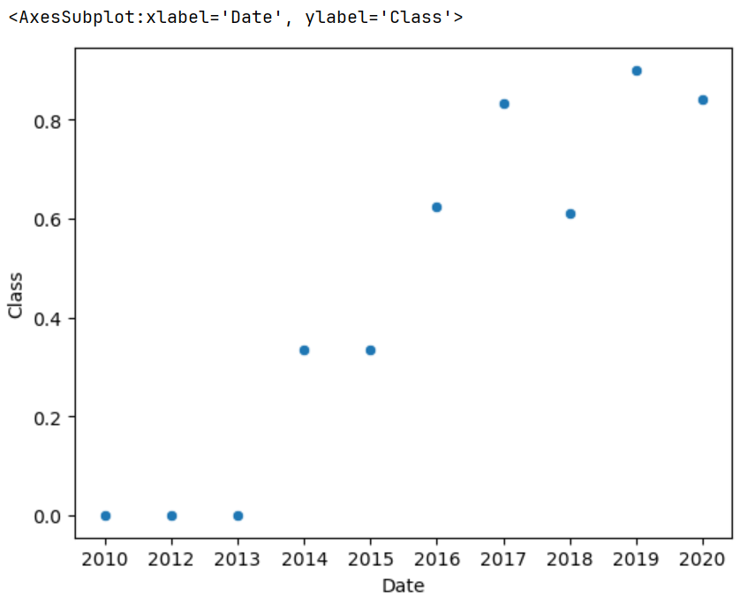
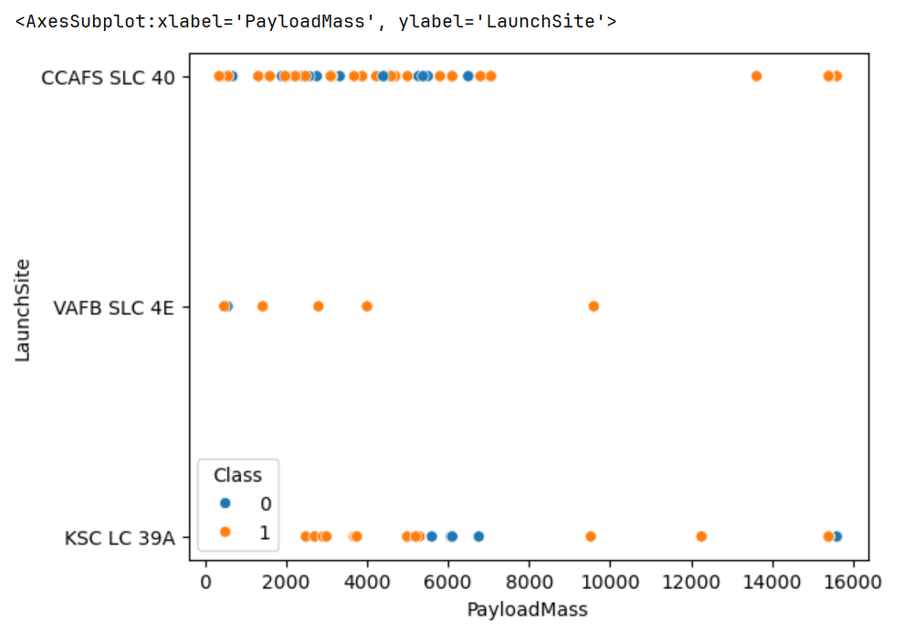
Results – EDA
Exploratory data analysis results
Total of 90 Falcon9 launches between 04-Jun-2010 and 05-Nov-2020 and success rate of 67%
41 mission outcomes successfully landed to a drone ship
ES-L1, GEO, HEO and SSO orbits have high average success rates
CCAFS SLC 40 site has maximum launches with high success rate, for both high and low payload
Success rate has an increasing trend, reflecting learnings from past launches

Slide 18
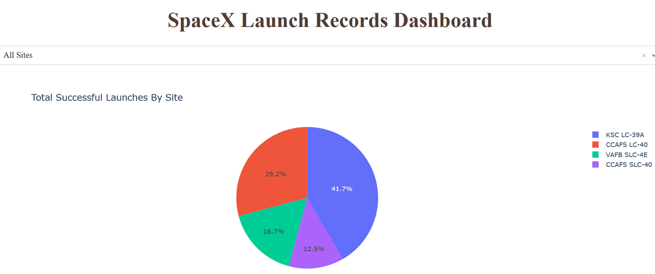
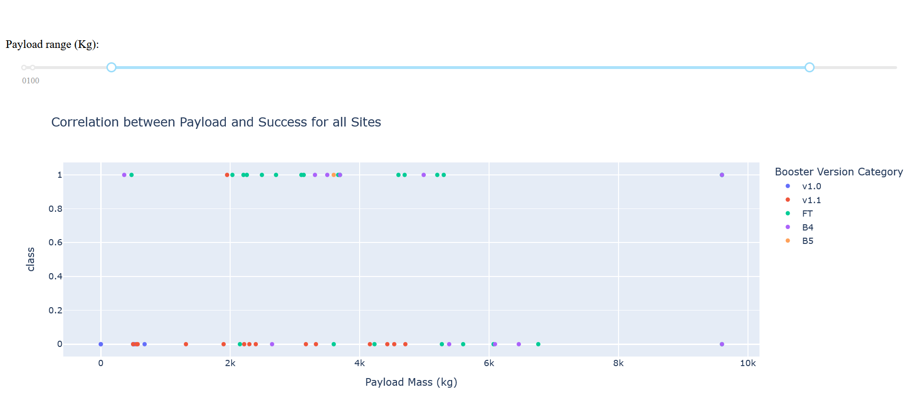
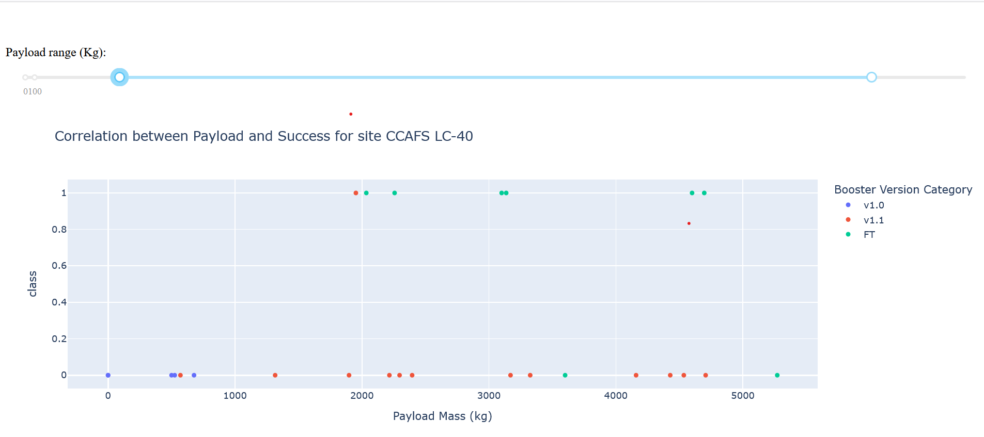
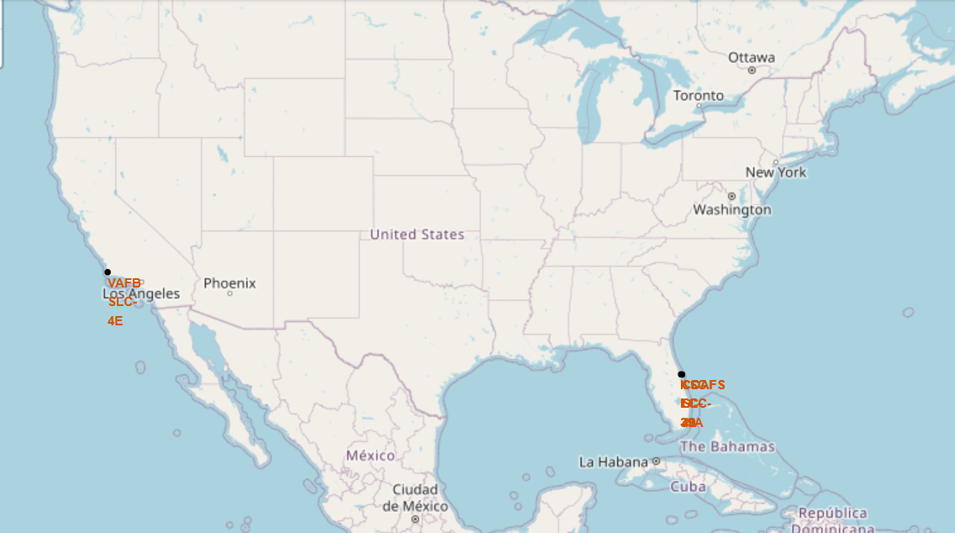
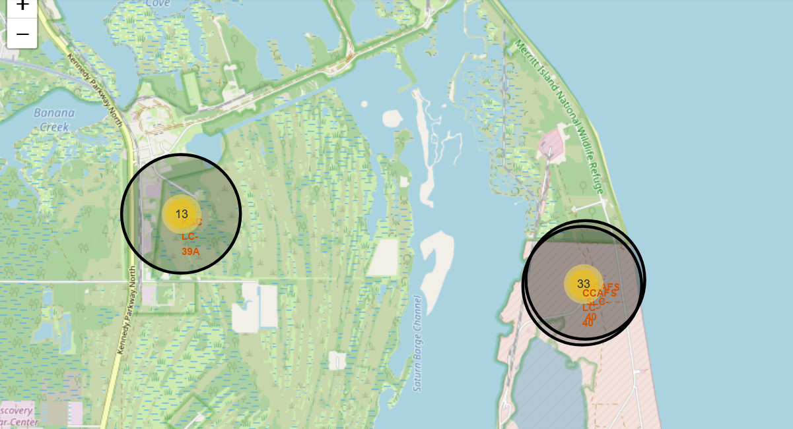
Results – Interactive Analytics

Slide 19
Results – Predictive Analysis
Predictive analysis results
20% data used for testing
Sigmoid kernel has the best result on the validation dataset for Support Vector Machine model
Accuracy of all 4 models based on test data = 83.33%
Of the 4 models, Decision Tree Classifier performed best for prediction based on confusion matrix

Slide 20

Section 2

Slide 21
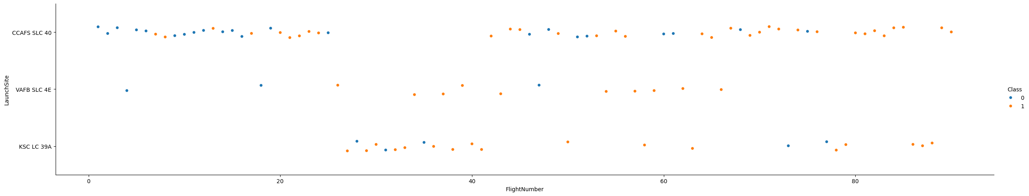
Flight Number vs. Launch Site

Slide 22
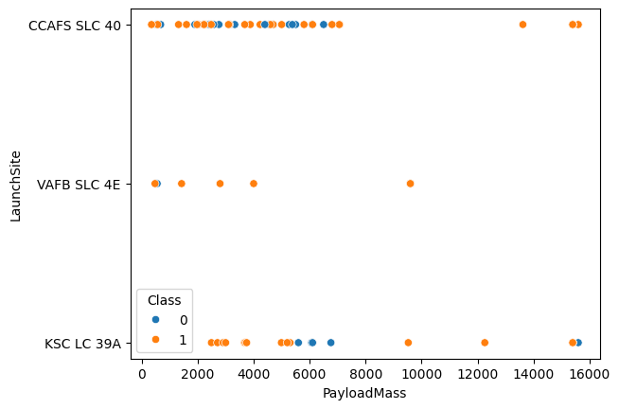
Payload vs. Launch Site

Slide 23
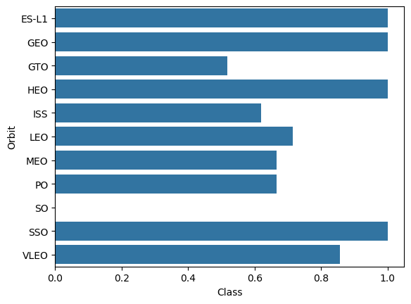
Success Rate vs. Orbit Type

Slide 24
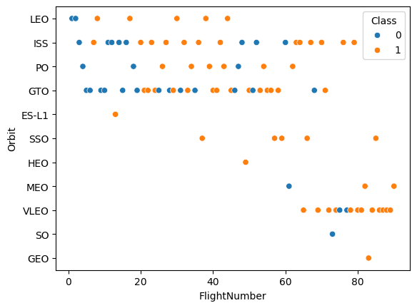
Flight Number vs. Orbit Type

Slide 25
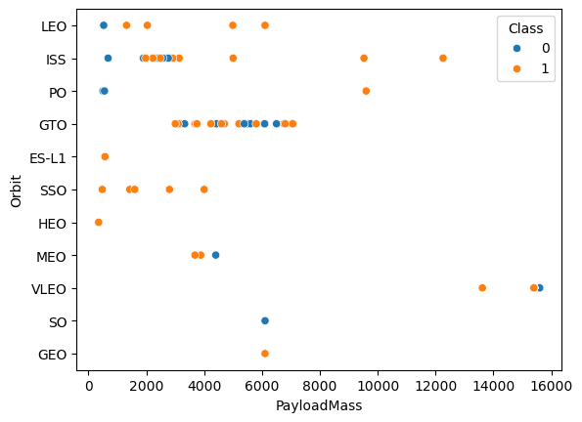
Payload vs. Orbit Type

Slide 26
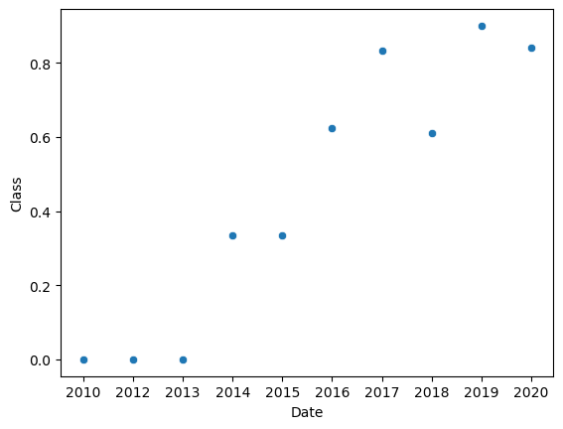
Launch Success Yearly Trend

Slide 27
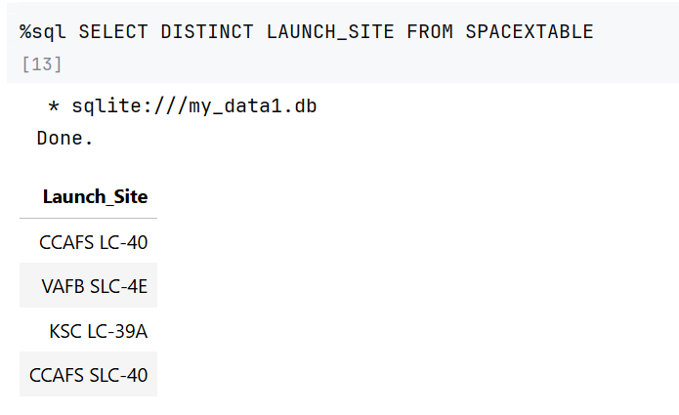
All Launch Site Names

Slide 28
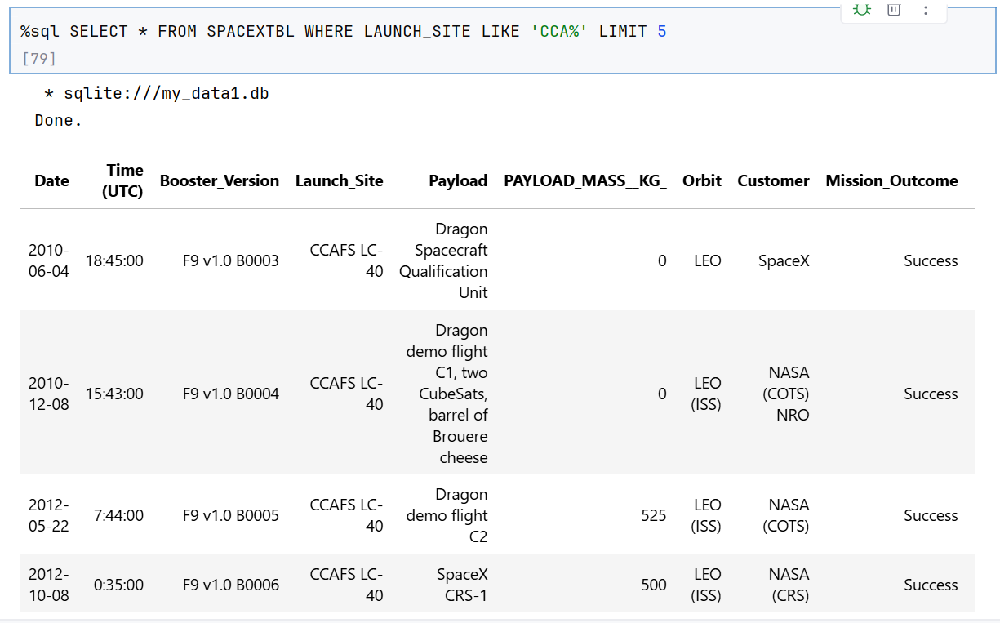
Launch Site Names Begin with 'CCA'

Slide 29
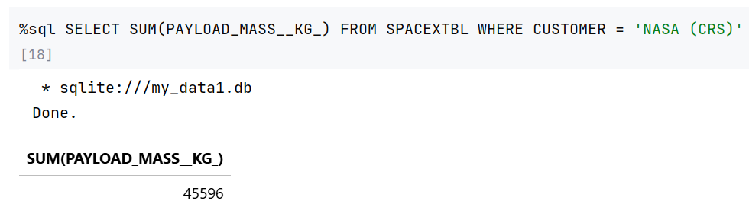
Total Payload Mass

Slide 30
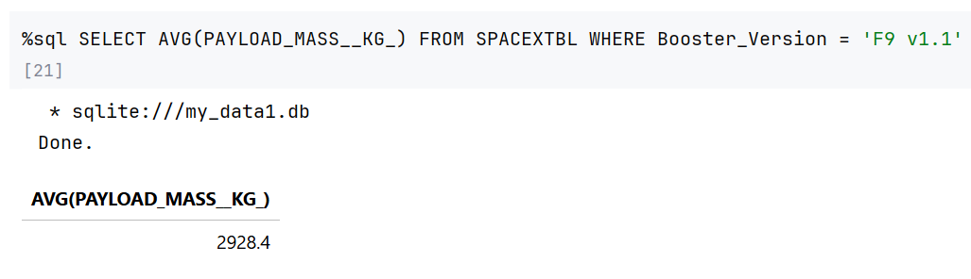
Average Payload Mass by F9 v1.1

Slide 31
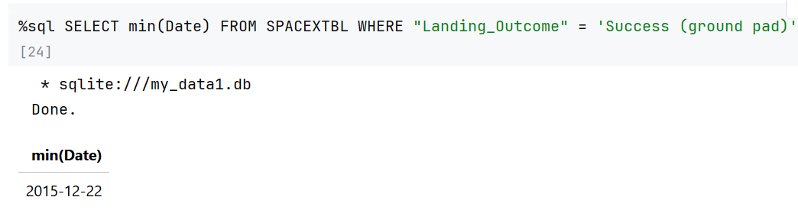
First Successful Ground Landing Date

Slide 32
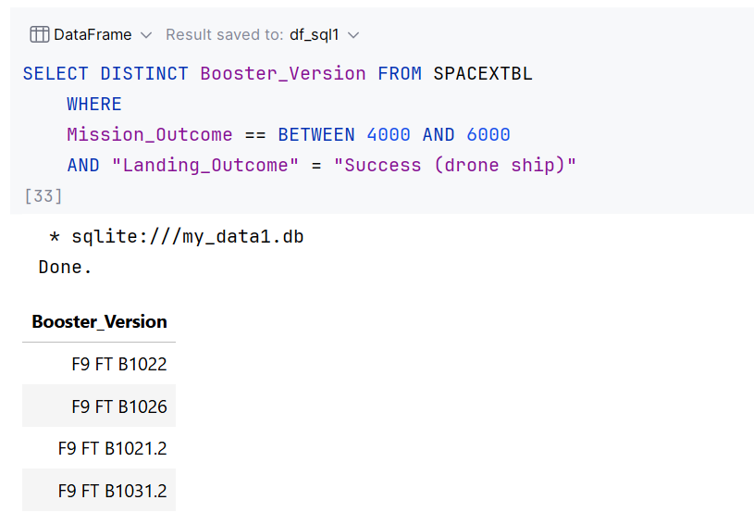
Successful Drone Ship Landing with Payload between 4000 and 6000

Slide 33
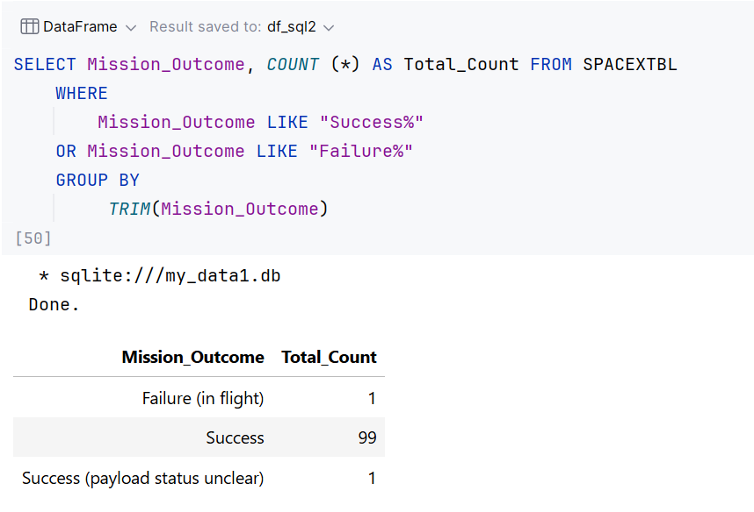
Total Number of Successful and Failure Mission Outcomes

Slide 34
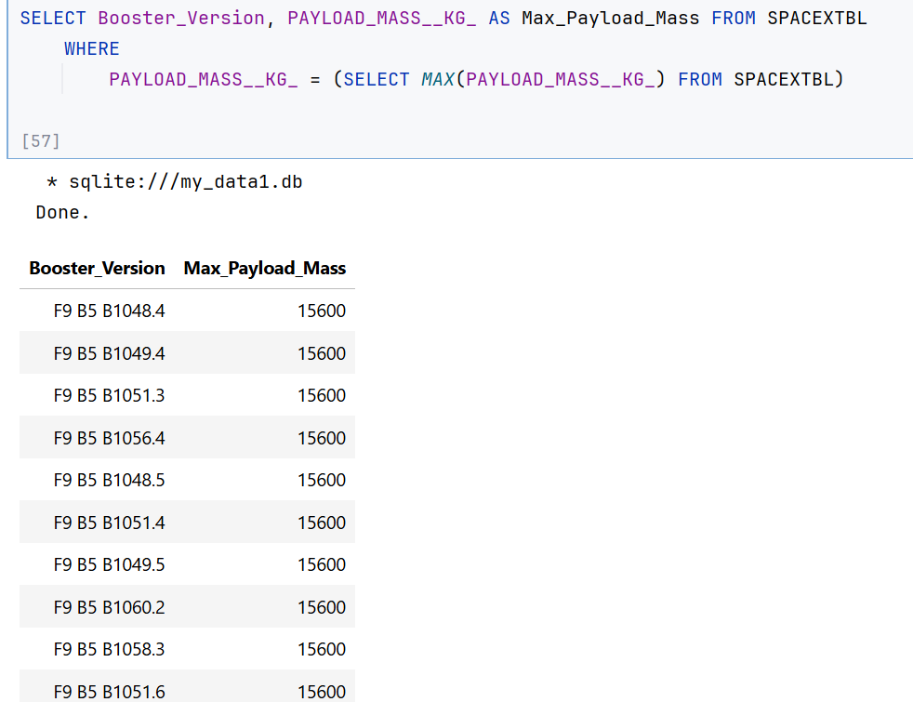
Boosters Carried Maximum Payload

Slide 35
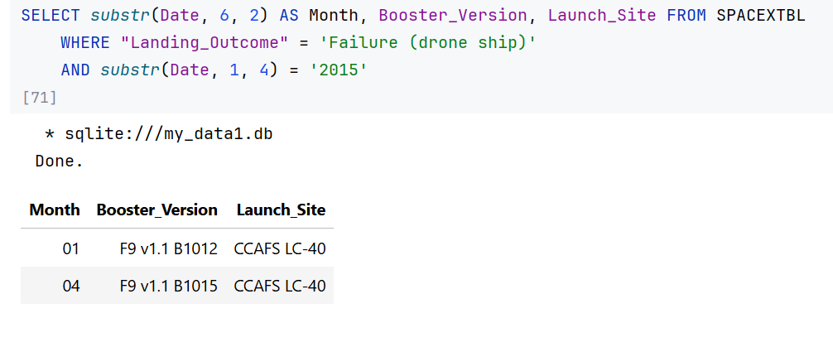
2015 Launch Records

Slide 36
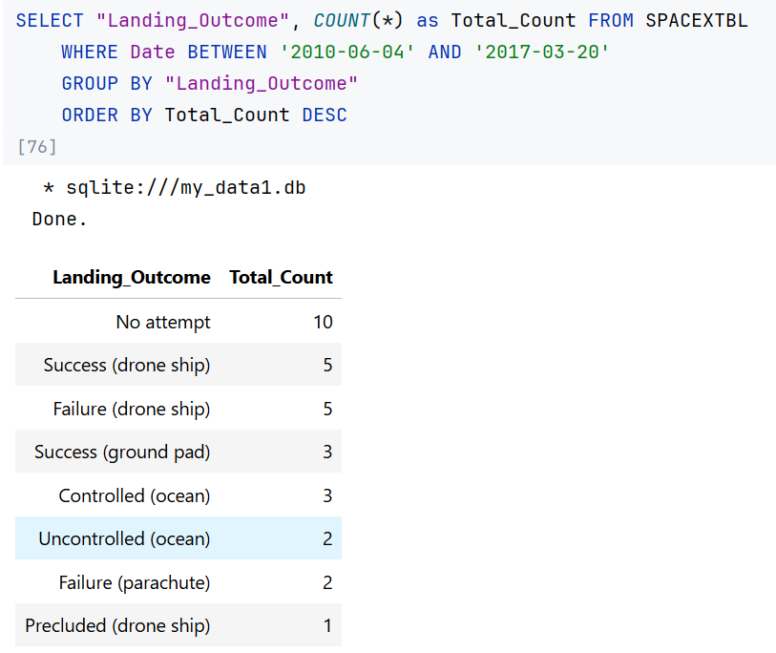
Rank Landing Outcomes Between 2010-06-04 and 2017-03-20

Slide 37

Section 3

Slide 38
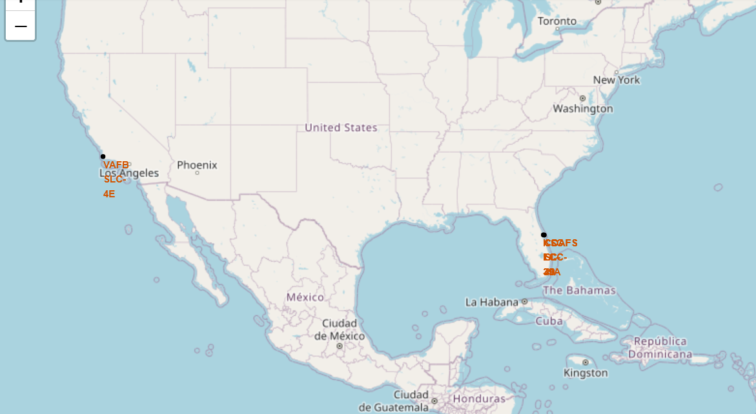
Launch Sites of Falcon9

Slide 39
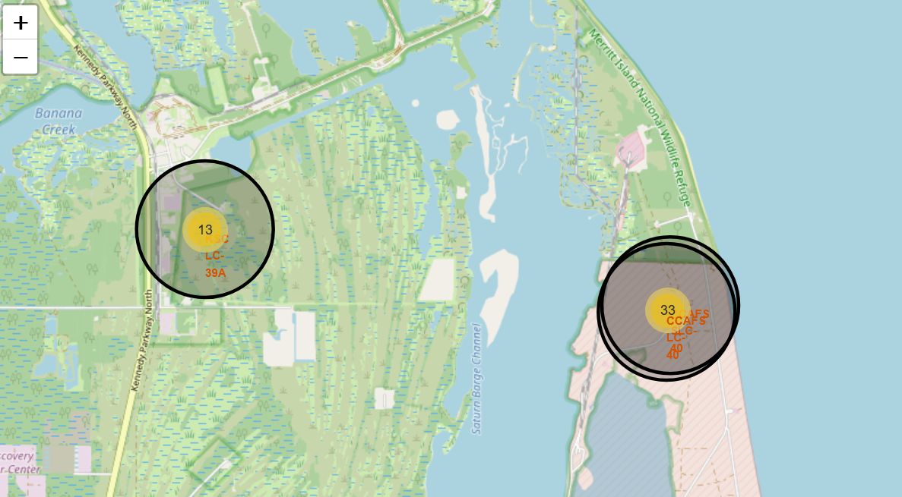
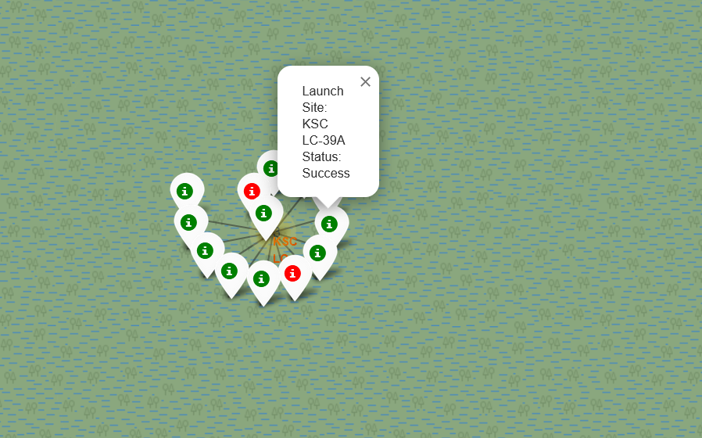
Eastern Launch Sites & KSCLC-39A Site Success/Failure Markings

Slide 40
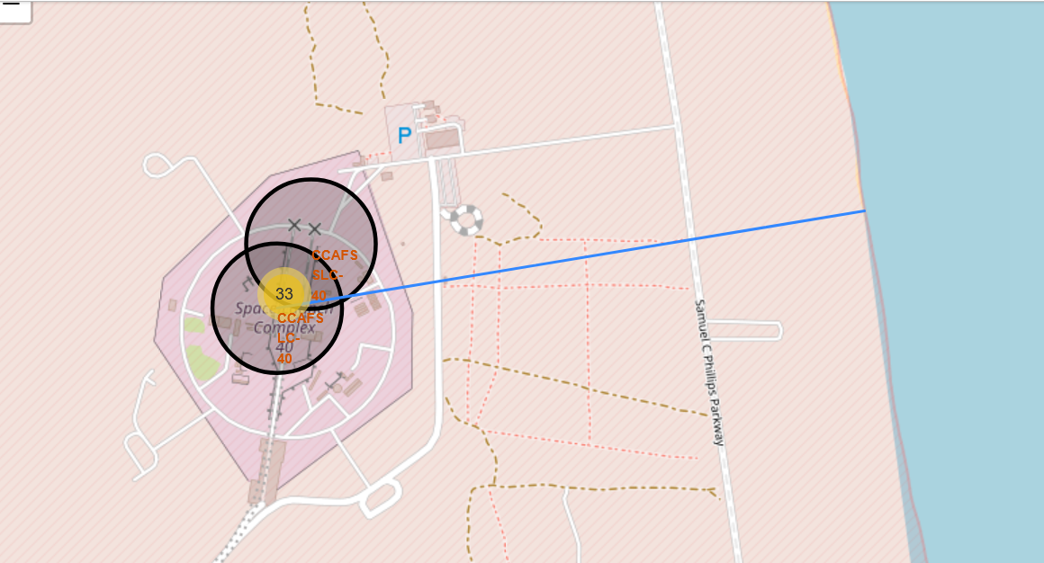
CCAFS SLC-40 Site Proximity to Coast (Blue Line)

Slide 41

Section 4

Slide 42
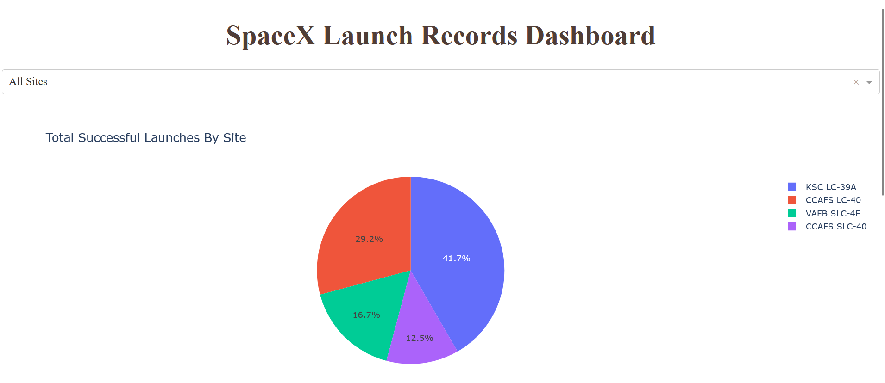
Success Rate of Launch – All Sites

Slide 43
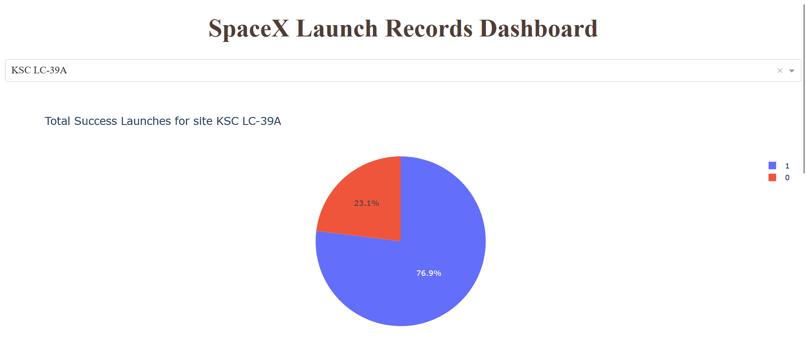
Pie Chart for Site with Highest Launch Success Ratio

Slide 44
Scatter Plot for Payload vs Success – All Sites

Slide 45

Section 5

Slide 46
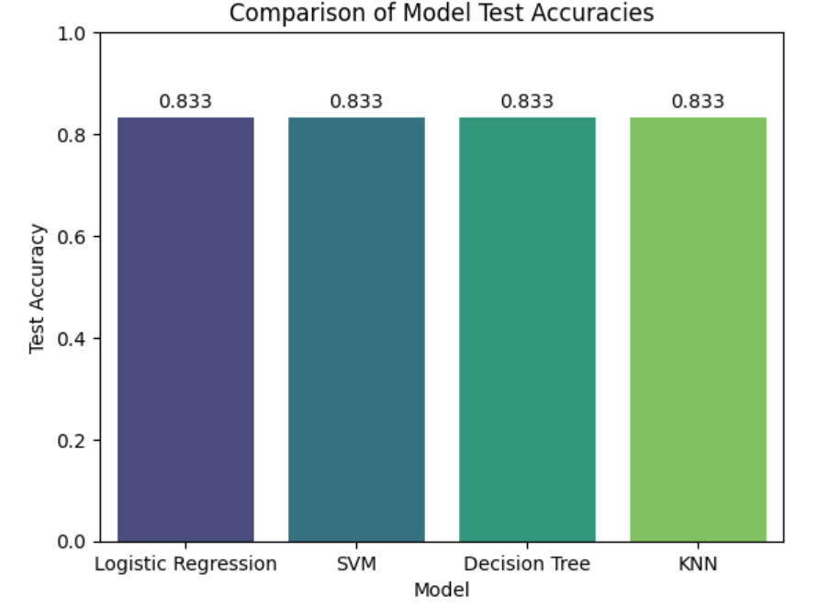
Classification Accuracy

Slide 47

Confusion Matrix – Best Model Decision Tree Classifier

Slide 48
Conclusions
Key features (Flight Number, Payload Mass, Launch Site, Orbit) provide a reliable approach for predicting launch success
All four models score a high of 83.33% of test accuracy,
Best model is Decision Tree Classifier as it has better reliability based on confusion matrix
Accurate prediction of launch success can help in cost optimization since the first stage launcher can be reused

Slide 49


Slide 50
Appendix

